Slide 1


Deep Learning
Deep Learning
Single and multilayer perceptrons

Slide 2

SIMPLE PERCEPTRON
Deep Learning
Biological metaphor and mathematical transposition

Slide 3
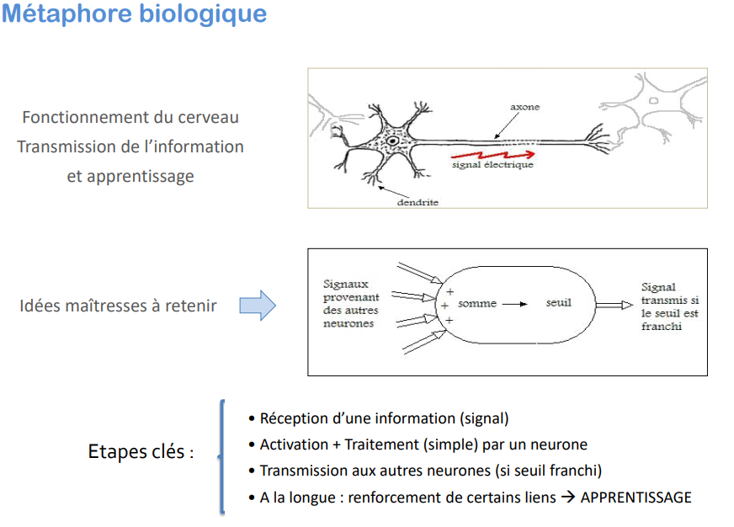
Biological metaphor
Deep Learning
How the brain works Information transmission and learning
Electrical signal
Incoming signals from other neurons
Transmitted signal if the threshold is surpassed
Key points to remember
Sum
Threshold
- Reception of an information (signal)
- Activation + Processing (simple) by a neuron
- Transmission to other neurons (if threshold is crossed)
- In the long run : reinforcement of certain links → LEARNING
Key Steps:

Slide 4
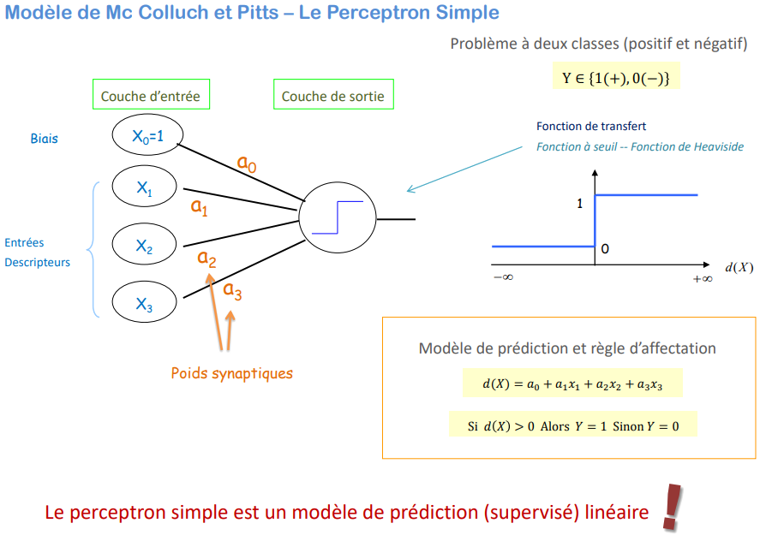
Model of Mc Colluch and Pitts - The Simple Perceptron
Deep Learning
Two class problem (positive and negative)
Input layer
Output layer
Bias
Transfer function
Threshold function -- Heaviside function
Inputs Descriptors
Prediction model and assignment rule
Synaptic weights
The simple perceptron is a linear (supervised) prediction model

Slide 5
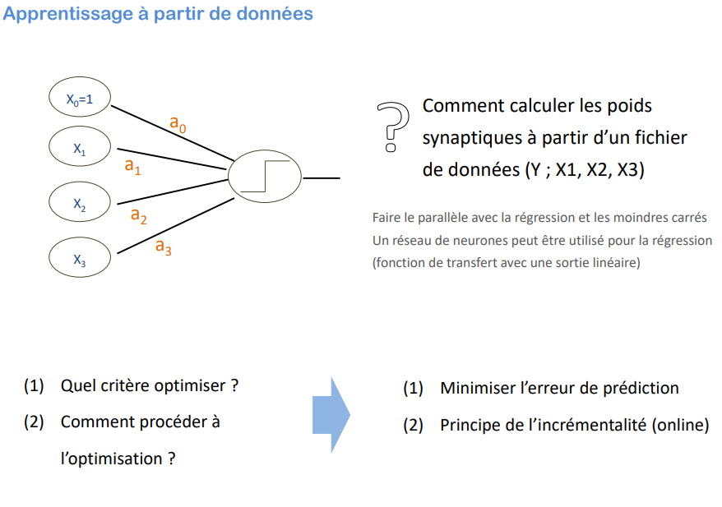
Learning from data
Deep Learning
How to calculate synaptic weights synaptic weights from a data file data file (Y ; X1, X2, X3)
Drawing a parallel with regression and least squares A neural network can be used for regression (transfer function with a linear output)
(1) Which criterion should be optimized?
(2) How to proceed to optimization ?
(1) Minimizing the prediction error
(2) Principle of incrementality (online)

Slide 6
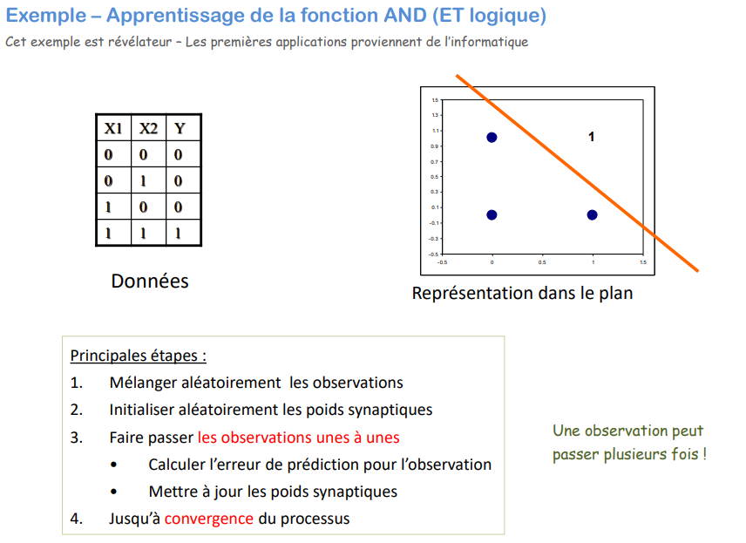
Example - Learning the AND function This example is revealing - The first applications come from the computer industry
Deep Learning
Data
Representation in the plane
Main steps:
1. Randomly shuffle the observations
2. Randomly initialize the synaptic weights
3. Shuffle the observations one by one
Calculate the prediction error for the observation
Update the synaptic weights
4. Until convergence of the process
An observation can pass several times!

Slide 7
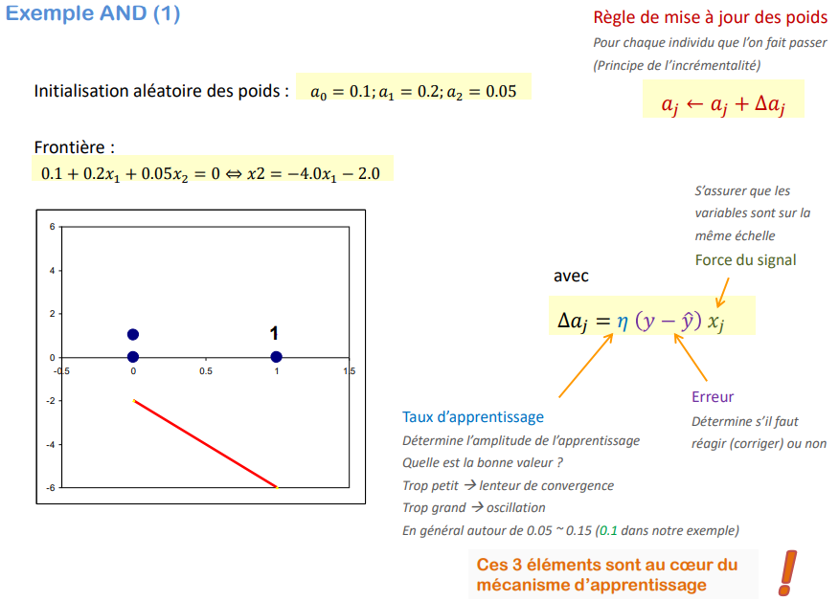
Example AND (1)
Deep Learning
Rule of update of the weights
For each individual that one makes pass
(Principle of the incrementality)
Random initialization of weights:
Make sure that the variables are on the same scale
Signal strength
With
Error
Determines whether to react (correct) or not
Learning rate
Determines the learning amplitude
What is the right value?
Too small → slow convergence
Too large → oscillation
Usually around 0.05 ~ 0.15 (0.1 in our example)
These 3 elements are at the heart of the learning mechanism

Slide 8
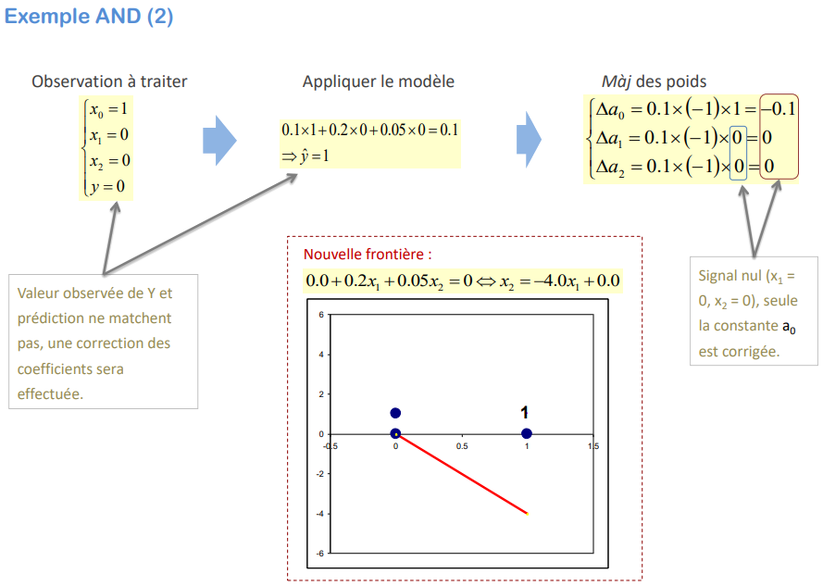
Example AND (2)
Deep Learning
Observation to be treated
Update of the weights
Apply the model
New frontier:
Zero signal (x1 = 0, x2 = 0), only the constant a0 is corrected.
Observed value of Y and prediction do not match, a correction of the coefficients will be made.

Slide 9
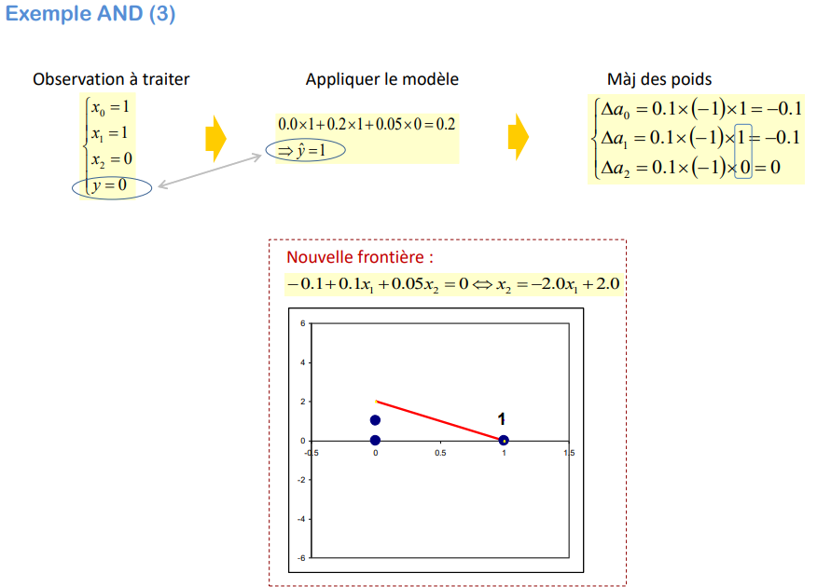
Example AND (3)
Deep Learning
Observation to be treated
Update of the weights
Apply the model
New frontier:

Slide 10
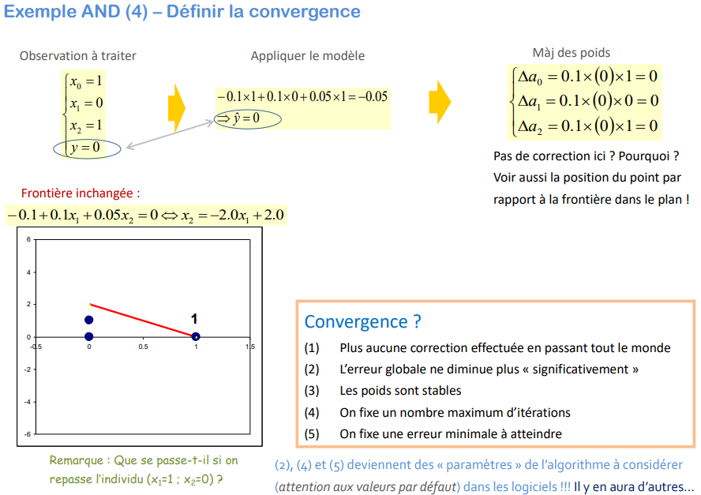
Example AND (4) - Defining convergence
Deep Learning
Observation to be treated
Update of the weights
Apply the model
No correction here? Why not?
See also the position of the point with respect to the boundary in the plane!
Unchanged border:
Convergence ?
(1) No more corrections made by passing everyone
(2) The global error does not decrease "significantly" anymore
(3) The weights are stable
(4) A maximum number of iterations is fixed
(5) We fix a minimum error to reach
Remark : What happens if we replay the individual (x1=1 ; x2=0) ?
(2), (4) and (5) become "parameters" of the algorithm to be considered (beware of default values) in software!!! There will be others...

Slide 11
FURTHER WITH THE SIMPLE PERCEPTRON
Deep Learning
Estimation of P(Y/X), gradient descent, multi-class problems

Slide 12
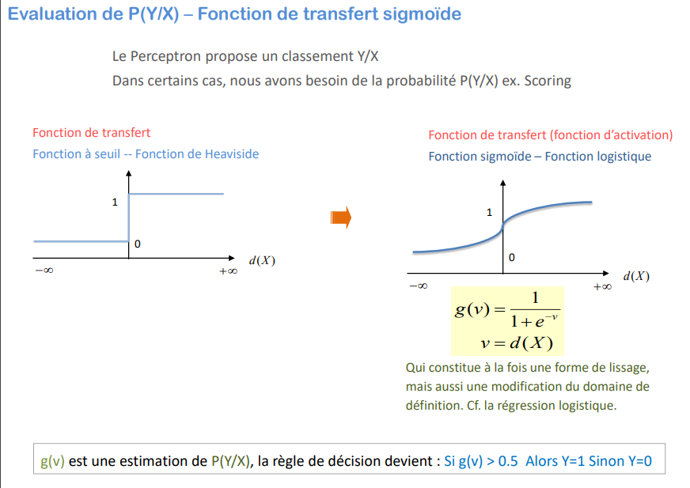
Evaluation of P(Y/X) - Sigmoid transfer function
Deep Learning
The Perceptron proposes a Y/X ranking
In some cases, we need the probability P(Y/X) e.g., Scoring
Transfer function
Threshold function -- Heaviside function
Transfer function (activation function)
Sigmoid function - Logistic function
This is both a form of smoothing and a modification of the domain of definition. Cf. logistic regression.
g(v) is an estimate of P(Y/X), the decision rule becomes: If g(v) > 0.5 Then Y=1 Otherwise Y=0

Slide 13
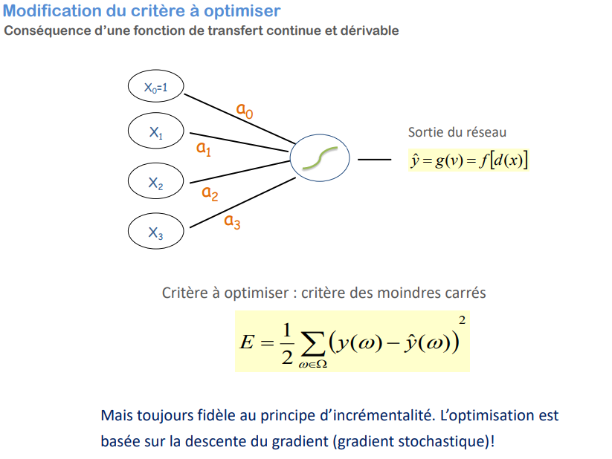
Modification of the criterion to be optimized Consequence of a continuous and derivable transfer function
Deep Learning
Exit from the network
Criterion to be optimized: least squares criterion
But always faithful to the principle of incrementality. The optimization is based on gradient descent (stochastic gradient)!

Slide 14
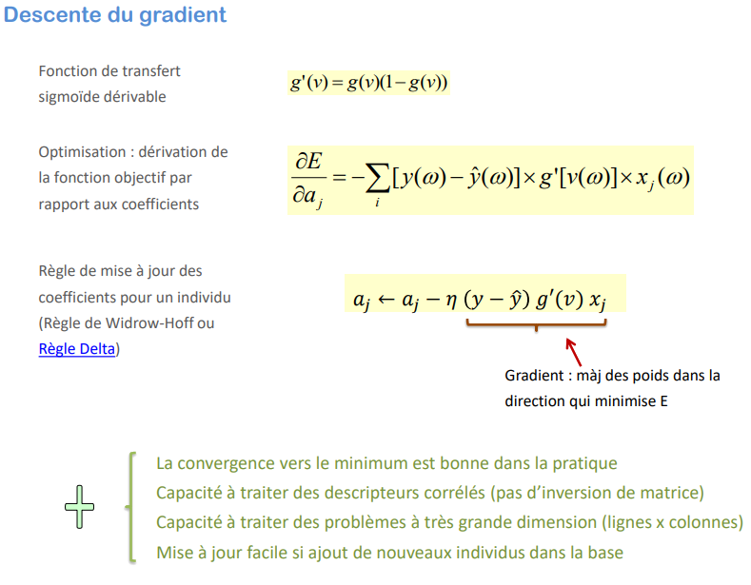
Gradient descent
Deep Learning
Transfer function derivable sigmoid
Optimization: derivation of the objective function with respect to the coefficients
Rule for updating the coefficients for an individual (Widrow-Hoff rule or Delta rule)
Gradient: update the weights in the direction that minimizes E
Convergence to the minimum is good in practice Ability to handle correlated descriptors (no matrix inversion) Ability to handle very high dimensional problems (rows x columns) Easy updating if new individuals are added to the database

Slide 15
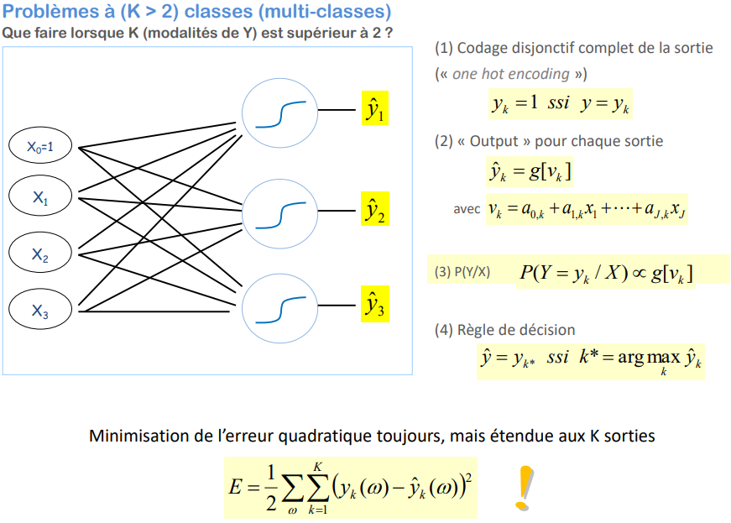
Problems with (K > 2) classes (multi-classes) What to do when K (modalities of Y) is greater than 2 ?
Deep Learning
(1) Full disjunctive output coding
("one hot encoding")
(2) "Output" for each output
With
(4) Decision rule
Minimization of the square error still, but extended to the K outputs

Slide 16
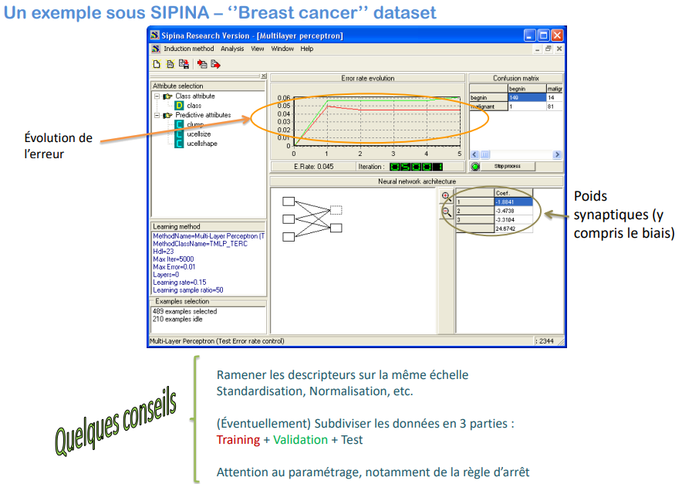
An example under SIPINA - ''Breast cancer'' dataset
Deep Learning
Evolution of the error
Synaptic weights (including bias)
Bringing descriptors to the same scale Standardization, normalization, etc.
(Eventually) Subdivide the data into 3 parts: Training + Validation + Test
Be careful with the parameterization, especially the stop rule
Some Advice

Slide 17
MULTILAYER PERCEPTRON
Deep Learning
Death and resurrection of the perceptron

Slide 18
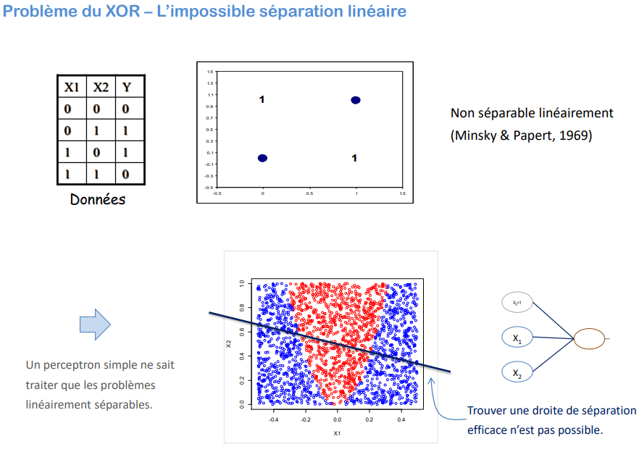
XOR problem - The impossible linear separation
Deep Learning
Not linearly separable (Minsky & Papert, 1969)
Data
A simple perceptron can only handle linearly separable problems.
Finding an efficient separation line is not possible.

Slide 19
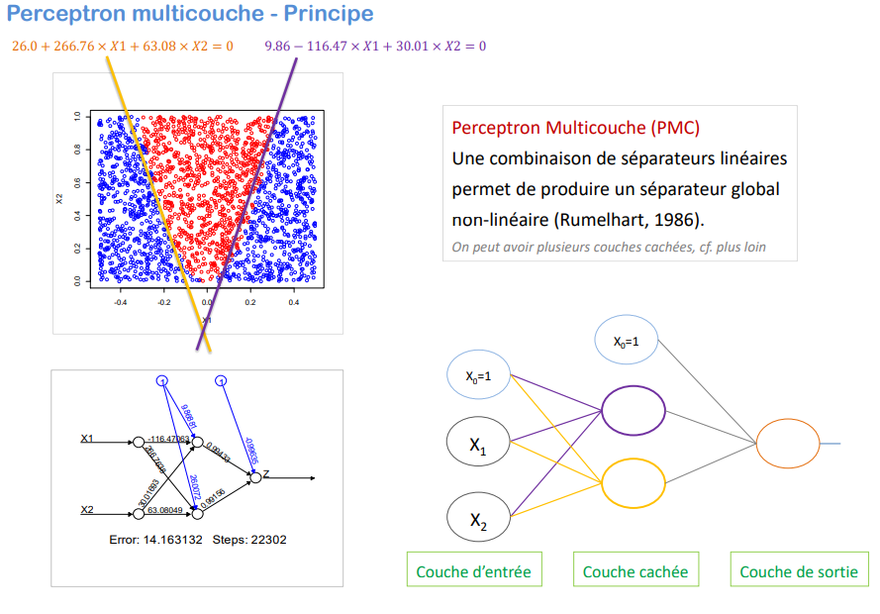
Multilayer perceptron - Principle
Deep Learning
Multilayer Perceptron (MLP)
A combination of linear separators produces a non-linear global separator (Rumelhart, 1986).
One can have several hidden layers, see below
Input Layer
Hidden Layers
Output Layer

Slide 20
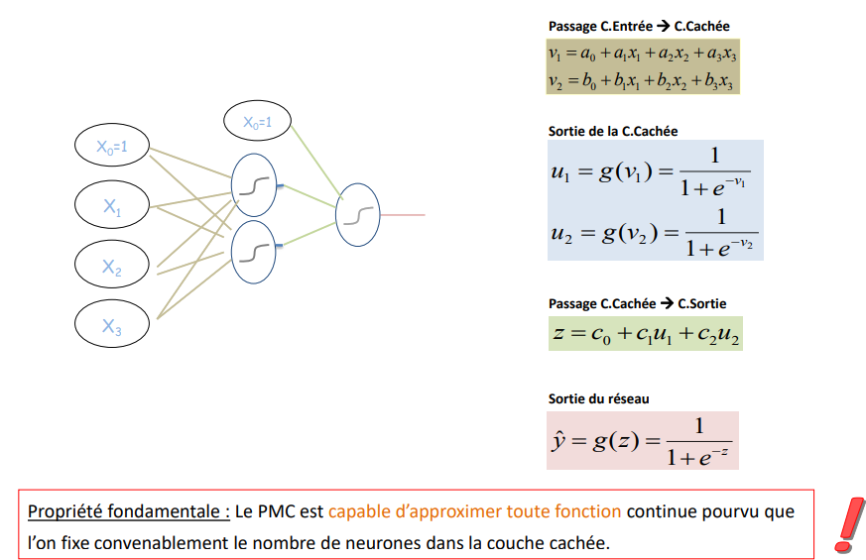
Multilayer perceptron - Formulas and properties Sigmoid transfer function in the hidden and output layers (it can be different, see below)
Deep Learning
Passage C.Input → C.Hidden
Exit of the C.Cachée
Passage C.Cachée → C.Sortie
Network output
A combination of linear separators produces a non-linear global separator (Rumelhart, 1986).

